Slide 1

Smart Vase (Smart Greenhouse) Project
Automated plant care with sensors, pumps, grow light, and a Bluetooth mobile app
Shayan Doroudiani • Mositto Robotics Academy
Teachers: Mr. Kalehr • Ms. Alizadeh

Slide 2
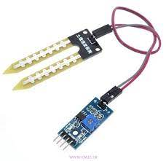
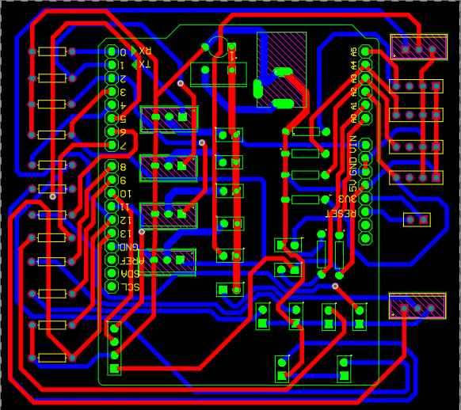
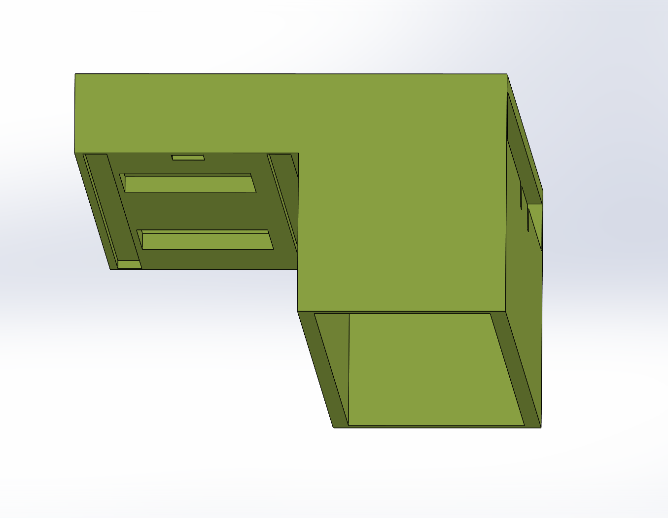
Agenda
What we built and what you’ll see
1. Introduction: What is a smart greenhouse?
2. Project goals & design constraints
3. Hardware: sensors, pumps, fan, and grow light
4. Circuit + PCB design (Altium)
5. Arduino firmware (auto/manual modes)
6. Mobile app (MIT App Inventor) + Bluetooth
7. Enclosure design (SolidWorks) + assembly
8. Results, challenges, and future upgrades
Soil moisture sensing (YL-69)
Custom PCB routing
SolidWorks enclosure model
Smart Vase (Smart Greenhouse) Project
2

Slide 3


Introduction
What is a smart greenhouse?
A smart greenhouse uses sensors + automation to keep plants healthy with less manual work.
In this project, we built a compact “smart vase” system that monitors light, temperature, and soil moisture, then automatically controls watering, airflow, and plant lighting.
Main parts of the project:
• Enclosure (box) + water tank
• Circuit + custom PCB
• Arduino programming (auto/manual)
• Mobile app (Bluetooth control)
Smart Vase (Smart Greenhouse) Project
3

Slide 4
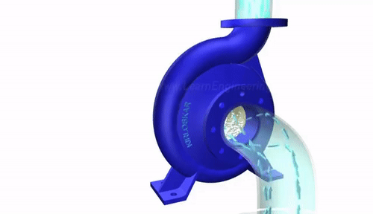
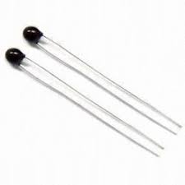
Project Goals
Why we built it
Save water
Healthier growth
Prevent drying
Water only when soil moisture is low (prevents overwatering).
Maintain better light + temperature conditions for steady growth.
Automated reminders and control reduce the chance a plant dries out.
Smart Vase (Smart Greenhouse) Project
4

Slide 5
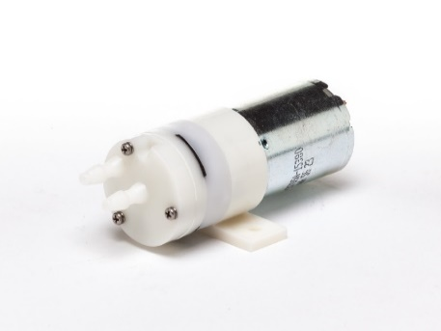
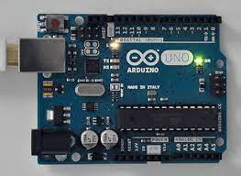
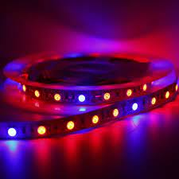

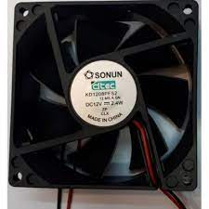

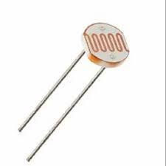
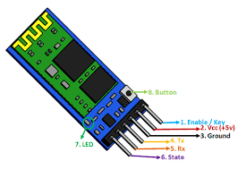
Tools & Materials
Hardware + software used in the build
Hardware
Software
4× 12V mini pumps
Arduino IDE (firmware)
12V grow LED strip
MIT App Inventor (mobile app)
12V fan
Altium Designer (PCB design)
Soil moisture sensors (YL-69)
SolidWorks (enclosure design)
LDR (light sensor) + thermistor
Bluetooth module (HC-05 style)
Tip: We used a 12V power rail for actuators and regulated logic signals through the Arduino + driver transistors.
Smart Vase (Smart Greenhouse) Project
5

Slide 6
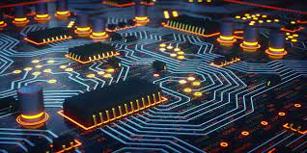
System Architecture
How everything connects (high-level)
Actuators • Pumps (×4) • Fan • Grow light
Sensors • Soil moisture (×4) • Light (LDR) • Temperature (thermistor)
Arduino UNO (Decision + Control)
Mobile App (Bluetooth)
Two operating modes:
• Auto: Arduino reads sensors and controls pumps/fan/light automatically.
• Manual: App sends commands over Bluetooth.
Smart Vase (Smart Greenhouse) Project
6

Slide 7
Sensors
What we measure to make decisions
Soil Moisture (YL-69)
Light (LDR)
Temperature (Thermistor)
Detects when soil is dry → triggers watering.
Example thresholds (tuned during testing):
• Moisture < 300 = dry
• Light < 300 = dark
Measures brightness → controls grow light when needed.
Example thresholds (tuned during testing):
• Moisture < 300 = dry
• Light < 300 = dark
Measures heat → can trigger fan for airflow.
Example thresholds (tuned during testing):
• Moisture < 300 = dry
• Light < 300 = dark
Smart Vase (Smart Greenhouse) Project
7

Slide 8
Actuators
What the system controls
Water Pumps (×4)
Grow Light (12V)
Fan (12V)
Each pot can be watered independently.
Driver circuit: IRF740 MOSFET + resistors + diode (flyback protection).
Adds light when the environment is too dark.
Driver circuit: IRF740 MOSFET + resistors + diode (flyback protection).
Improves airflow and helps regulate temperature.
Driver circuit: IRF740 MOSFET + resistors + diode (flyback protection).
We used a separate 12V rail for motors/LEDs and shared a common ground with the Arduino to avoid unstable readings.
Smart Vase (Smart Greenhouse) Project
8

Slide 9
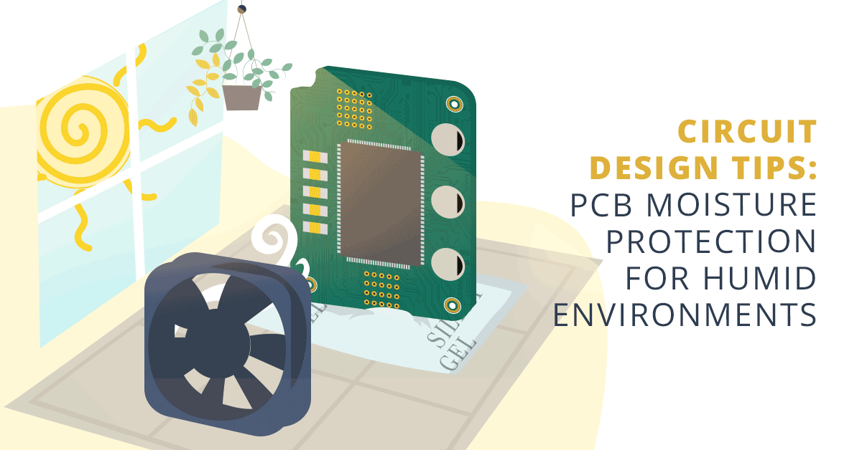
Circuit + PCB Design
Designed in Altium Designer
Why a custom PCB?
• Cleaner wiring and easier debugging • More reliable connections for multiple sensors • Dedicated MOSFET drivers for 12V pumps/fan/light • Compact form factor that fits inside the enclosure
Smart Vase (Smart Greenhouse) Project
9

Slide 10
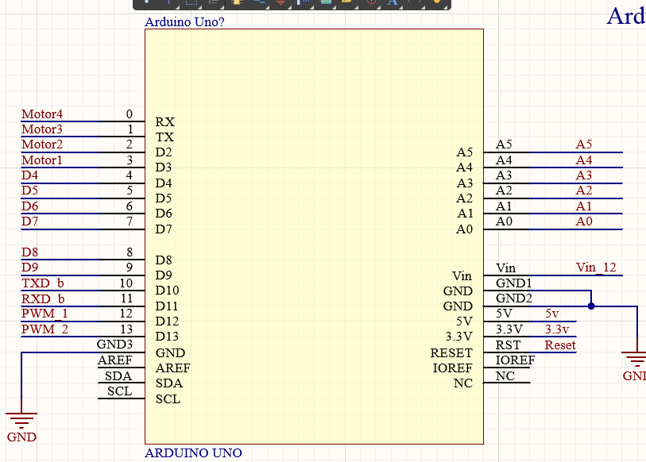
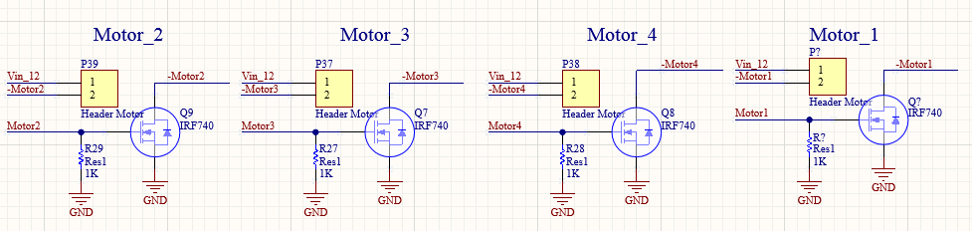
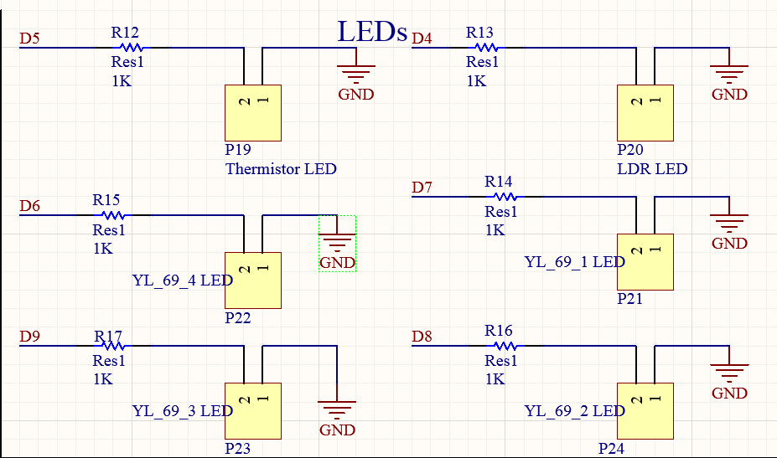
Schematic Highlights
Key sections of the circuit
Arduino pin mapping (digital + analog)
Motor drivers (MOSFET switches)
Indicator LEDs for sensors
Smart Vase (Smart Greenhouse) Project
10

Slide 11
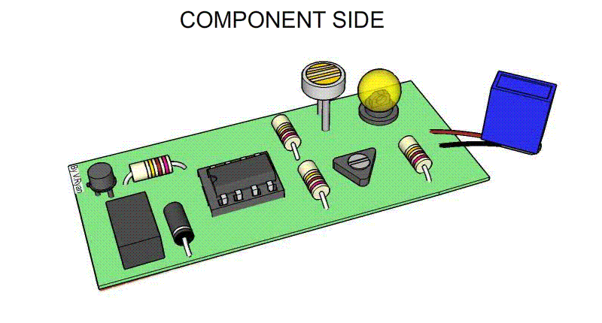
PCB Layout
Routing + 3D view
Moisture protection
Since this project works near water and soil, we: • Kept high-current traces wider • Added spacing between 12V and signal traces • Used an enclosed box to reduce splashes
Smart Vase (Smart Greenhouse) Project
11

Slide 12

Arduino Firmware
Auto / manual logic (highlights)
Reads 4 moisture sensors + LDR + thermistor
Auto mode: compares readings to thresholds → turns pumps/fan/light on/off
Manual mode: app can directly toggle outputs via Bluetooth commands
Safety: pumps are time-limited to avoid flooding
// Example: read moisture and drive one pump in Auto mode int moisture = analogRead(A0); if (autoMode) { if (moisture < DRY_THRESHOLD) { digitalWrite(PUMP_1, HIGH); delay(1200); // short burst watering digitalWrite(PUMP_1, LOW); } }
Smart Vase (Smart Greenhouse) Project
12

Slide 13

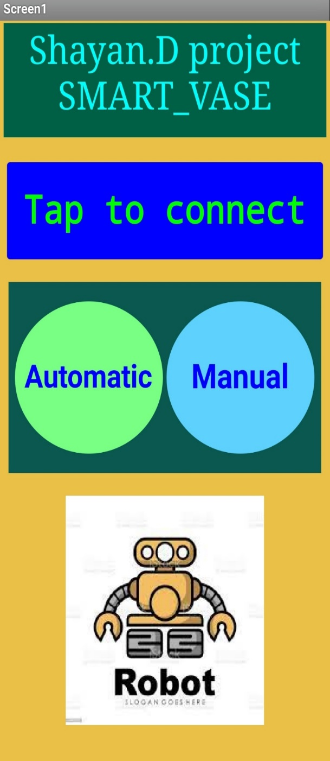
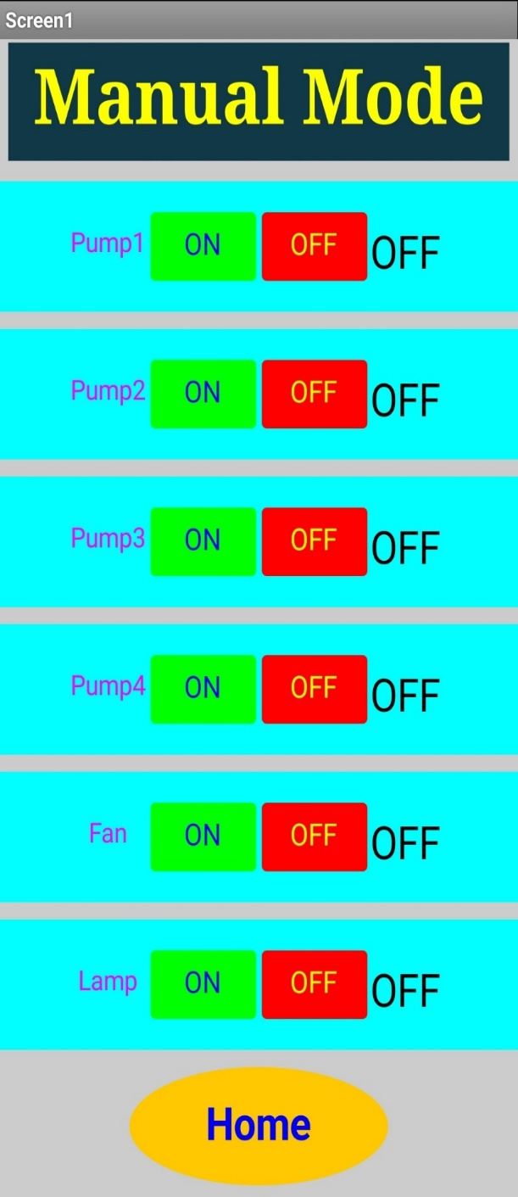
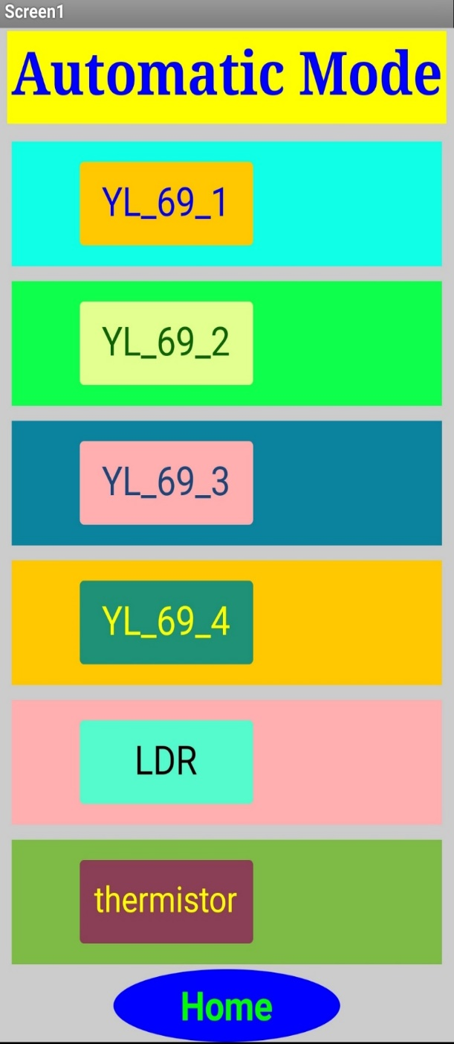
Mobile App (Bluetooth)
Built with MIT App Inventor
Connects to the Bluetooth module and sends single-character commands.
Home screen: connect + choose Auto or Manual.
Manual mode: directly toggle Pump1–Pump4, Fan, and Lamp.
Auto mode: displays live readings and system status (on/off).
Smart Vase (Smart Greenhouse) Project
13

Slide 14
Bluetooth Communication
Simple command protocol
Module setup
• VCC → 5V, GND → GND • TX/RX connected to Arduino serial pins • Tested pairing and stable baud rate before final assembly
Command examples
P1_ON, P1_OFF, ... FAN_ON / FAN_OFF LAMP_ON / LAMP_OFF AUTO / MANUAL
Design choice: a lightweight command list kept the app simple and reduced bugs during testing.
Smart Vase (Smart Greenhouse) Project
14

Slide 15
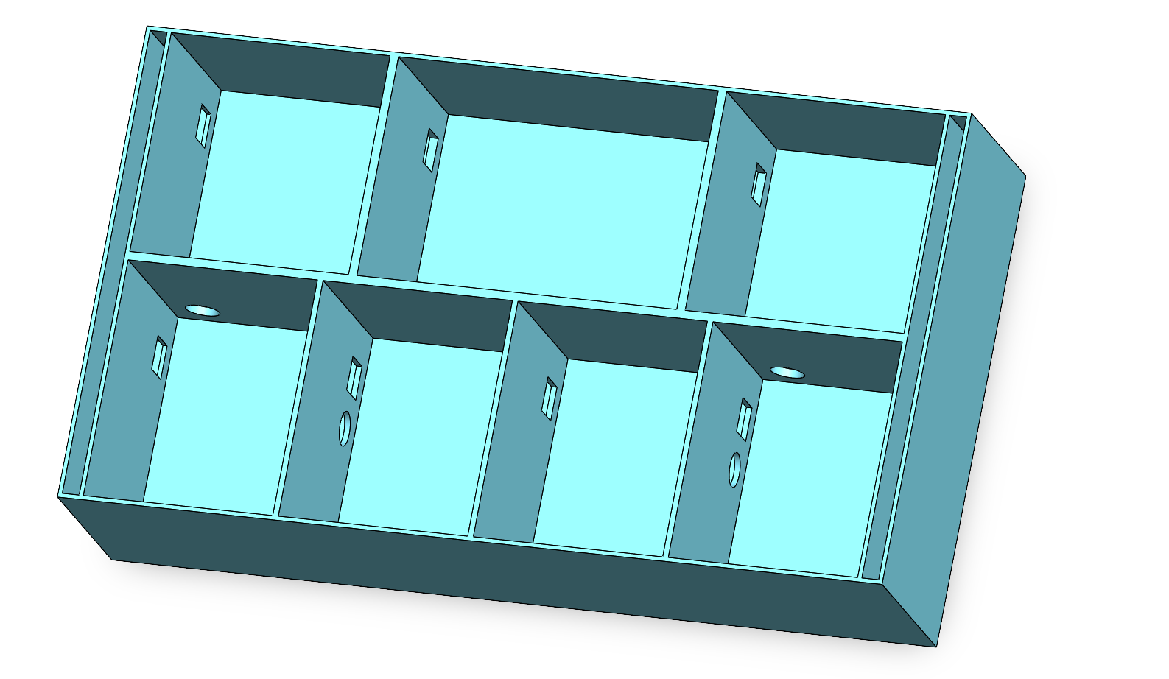
Enclosure Design
SolidWorks model + build requirements
Design requirements
• Separate electronics chamber (protected from leaks)
• Dedicated slots for pumps + tubing
• Airflow openings for the fan
• Accessible lid for maintenance + refilling the water tank
• Sensor placement aligned with pots for accurate readings
• Cable routing holes to keep the interior organized
Smart Vase (Smart Greenhouse) Project
15

Slide 16
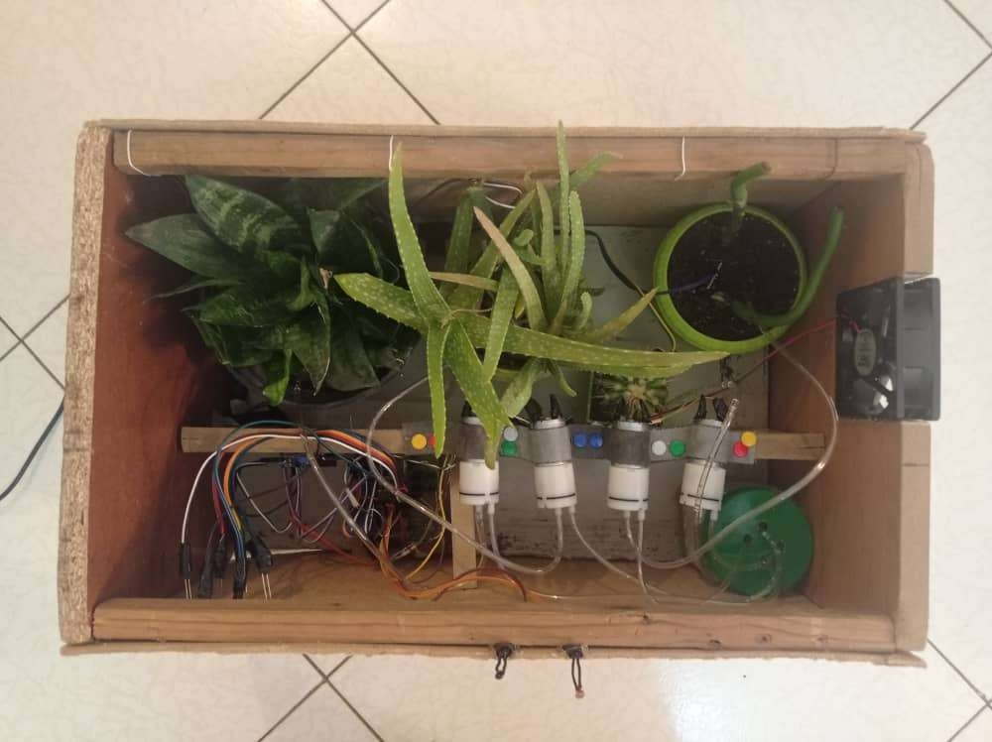
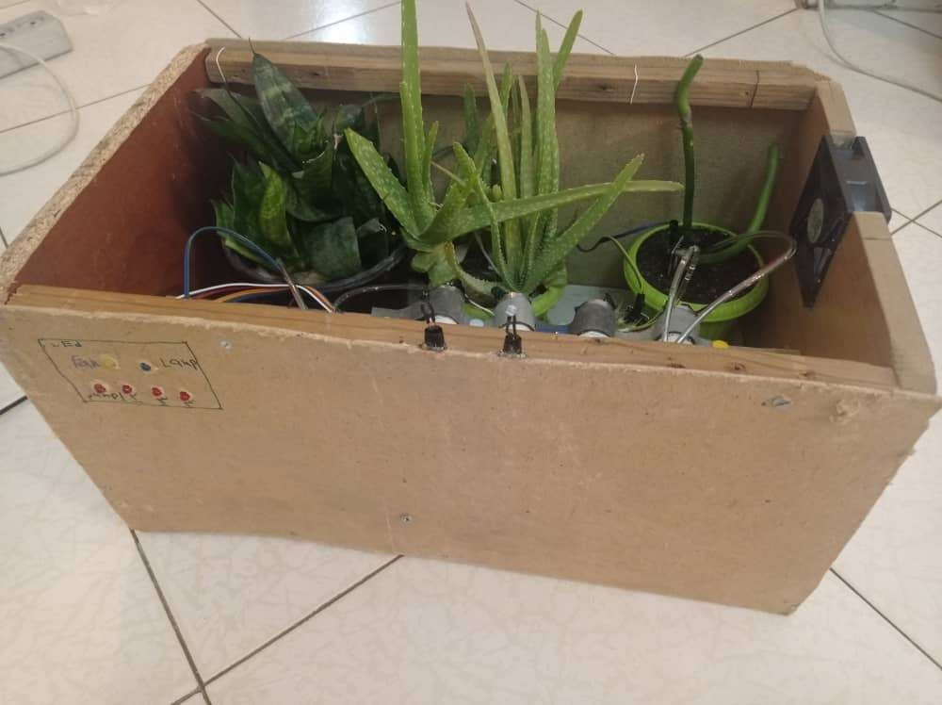
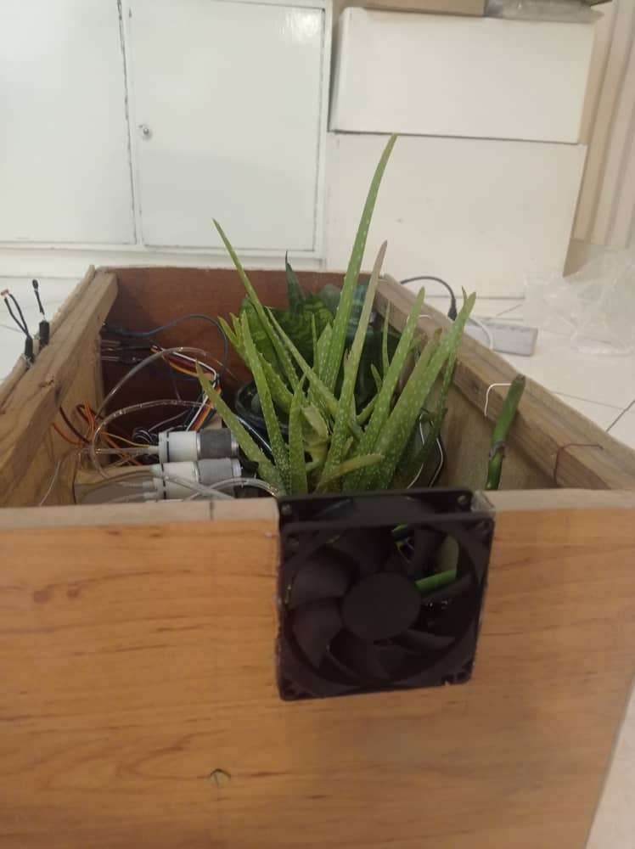
Final Prototype
Build + demo photos
What worked well
• Stable sensor readings after using a common ground and cleaner wiring
• Auto watering responded correctly to dry-soil thresholds
• App successfully controlled each device in Manual mode
• Fan + light improved plant environment during testing
Demo visuals
Smart Vase (Smart Greenhouse) Project
16

Slide 17

Challenges & Fixes
What we learned during debugging
Noisy sensor readings
Fixed by better wiring, common ground, and moving power lines away from analog inputs.
Pump backflow / leaks
Used tighter tubing + checked seals; kept electronics in a separate chamber.
(Gifs from testing & design iterations)
Bluetooth disconnects
Kept commands simple; tested baud rate and pairing before final mounting.
Space constraints
Repositioned components and used a custom PCB layout to reduce clutter.
Smart Vase (Smart Greenhouse) Project
17

Slide 18

Future Improvements
How we would make it even better
• Add a real-time display (OLED) to show moisture/temp/light on-device
• Replace Bluetooth with Wi‑Fi (ESP32) for remote monitoring
• Add a water-level sensor to avoid running pumps dry
• Improve moisture sensors (capacitive type) for longer lifetime
• Log data to graphs (weekly trends) inside the app
• 3D‑print enclosure parts for stronger waterproofing and cleaner finish
Smart Vase (Smart Greenhouse) Project
18

Slide 19
Conclusion
Key takeaway
By combining sensors, control logic, and a simple mobile interface, we built a working smart-vase system that can care for plants automatically.
This project strengthened our skills in: • Electronics + power management • PCB design (schematic → layout) • Embedded programming (Arduino) • App development + Bluetooth communication • Mechanical design + prototyping
Project files / download (from original deck):
picofile.com/vhEN/Smart_Vase.rar.html
Smart Vase (Smart Greenhouse) • Mositto Robotics Academy
19

Slide 20
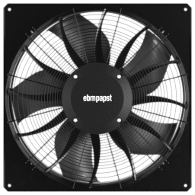
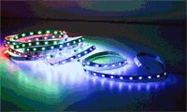


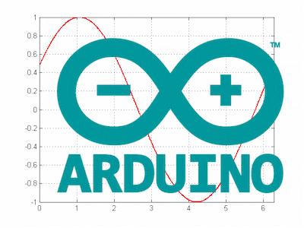
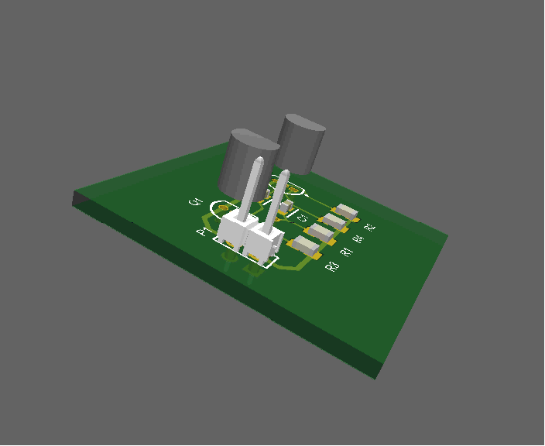


Visual Appendix
All images & GIFs from the original presentation (page 1)
Smart Vase • Visual Appendix
20

Slide 21


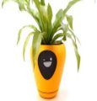
Visual Appendix
All images & GIFs from the original presentation (page 2)
Smart Vase • Visual Appendix
21

Slide 22

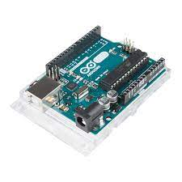
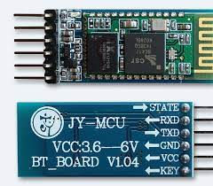
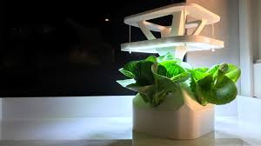

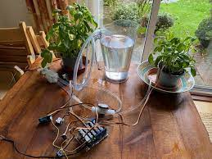
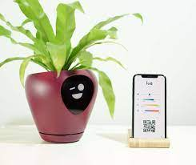
Visual Appendix
All images & GIFs from the original presentation (page 3)
Smart Vase • Visual Appendix
22

Slide 23
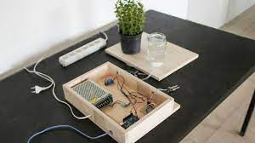
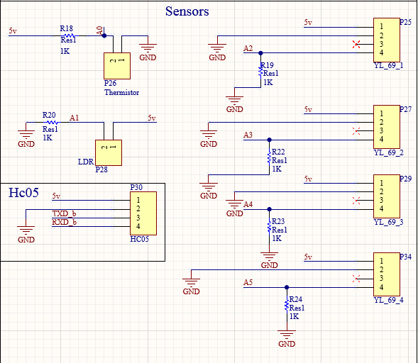
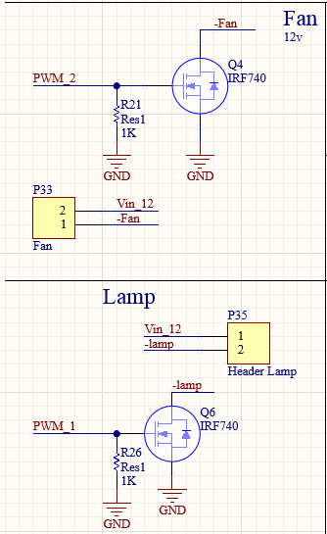
Visual Appendix
All images & GIFs from the original presentation (page 4)
Smart Vase • Visual Appendix
23

Slide 24
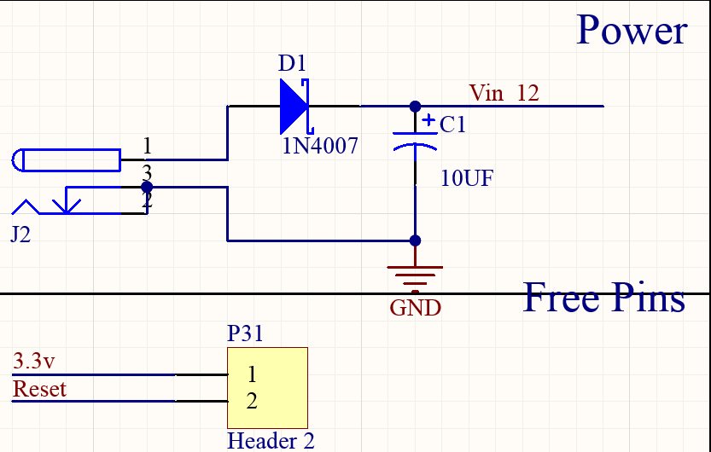

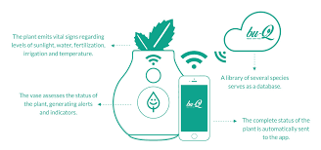
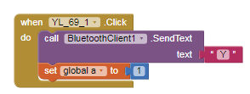
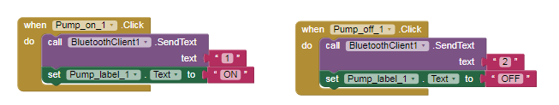
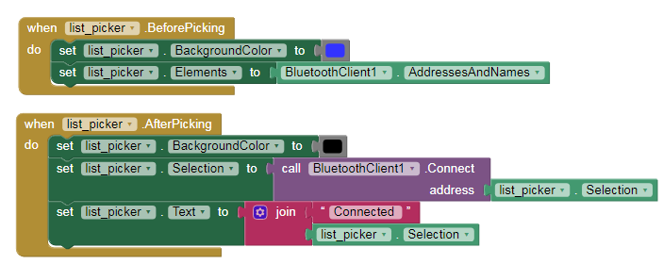
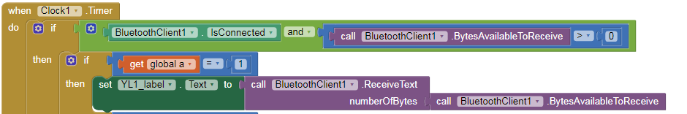

Visual Appendix
All images & GIFs from the original presentation (page 5)
Smart Vase • Visual Appendix
24

Slide 25
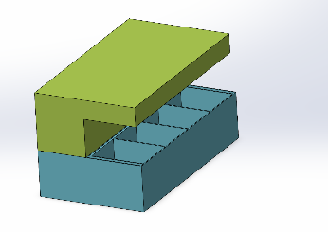
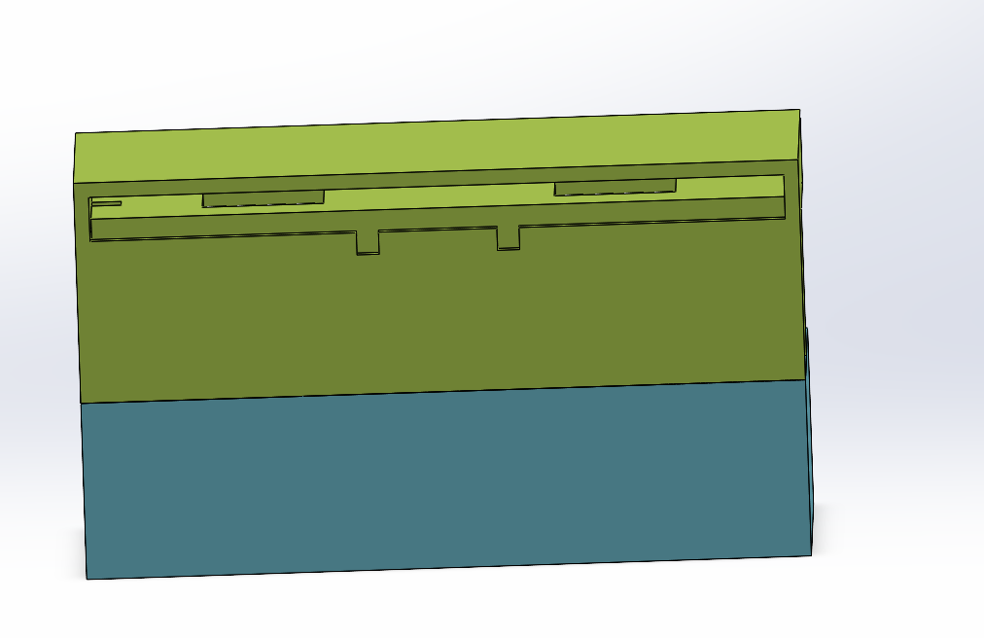
Visual Appendix
All images & GIFs from the original presentation (page 6)
Smart Vase • Visual Appendix
25

